Slide 1
SUPPLY CHAIN MANAGEMENT

Slide 2
Learning outcomes
Identify the main elements of supply chain management and their relationship to the value chain and value networks
Assess the potential of information systems to support supply chain management and the value chain.

Slide 3
Management issues
Which technologies should we deploy for supply chain management and how should they be prioritized?
Which elements of the supply chain should be managed within and beyond the organization and how can technology be used to facilitate this?

Slide 4
SCM – some definitions
Supply chain management (SCM) The coordination of all supply activities of an organization from its suppliers and partners to its customers
Upstream supply chain Transactions between an organization and its suppliers and intermediaries, equivalent to buy-side e-commerce
Downstream supply chain Transactions between an organization and its customers and intermediaries, equivalent to sell-side e-commerce.

Slide 5
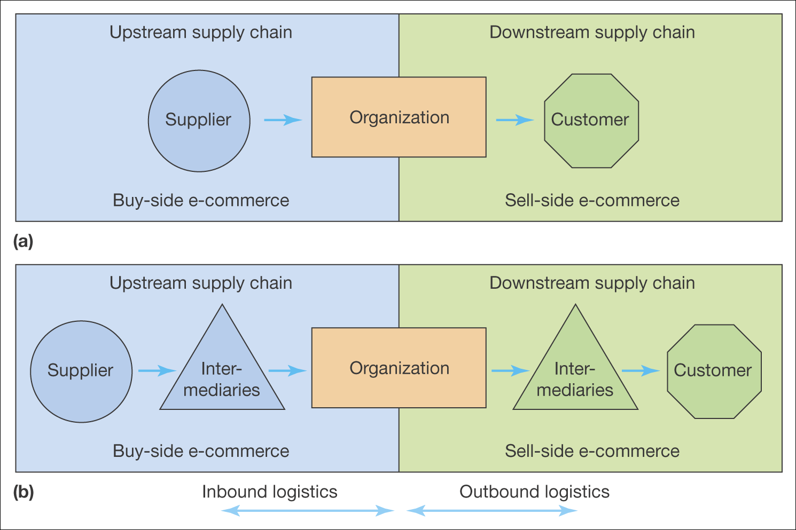
Figure 6.1 Members of the supply chain: (a) simplified view, (b) including intermediaries

Slide 6
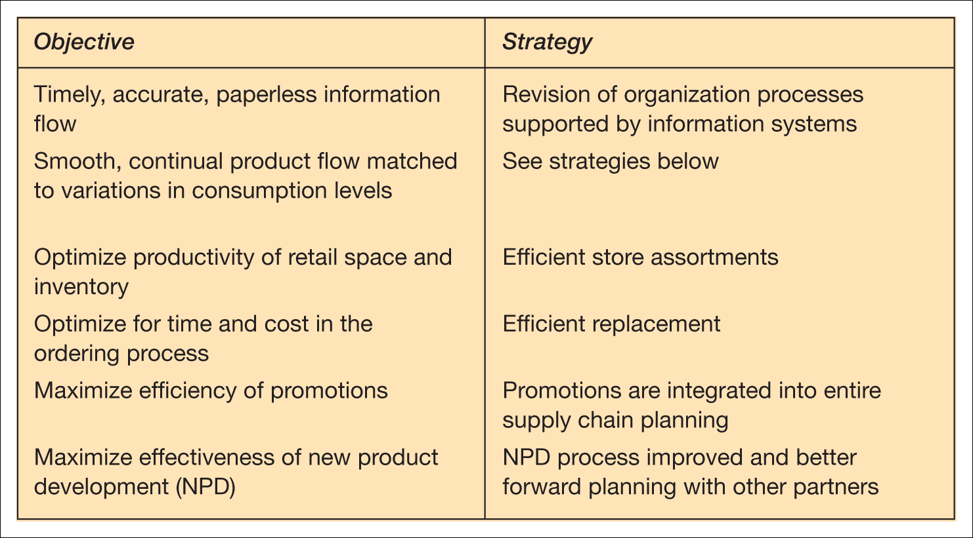
Table 6.1 Objectives and strategies for effective consumer response (ECR)

Slide 7
Using technology to support SCM
Early implementation: 1989-1993
  PC-based EDI purchasing system
Electronic trading gateway:1990-1994
  EDI-based but involved a wider range of parties
The move towards Internet commerce: 1996 onwards
  Provide a lower-cost alternative to traditional EDI

Slide 8
A history of SCM at BHP Steel
Early implementation 1989-1993. This was a PC-based EDI purchasing system.
Objectives:
  reduce data errors to 0,
  reduce administration costs,
  improve management control,
  reduce order lead time.
Benefits included:
  rationalization of suppliers to 12 major partnerships (accounting for 60% of invoices).
  80% of invoices placed electronically by 1990.
  7000 items were eliminated from the warehouse, to be sourced directly from suppliers, on demand.
  Shorter lead times in the day to day – from 10 days to 26 hours for items supplied through a standard contract and from 42 days to 10 days for direct-purchase items.
Barriers:
  Mainly technological.

Slide 9
Electronic trading gateway 1990-1994
Character
  Also EDI-based, but involved a wider range of parties both externally (from suppliers through to customers) and internally (from marketing, sales, finance, purchasing and legal)
Aim
  Provide a combined upstream and downstream supply chain solution to bring benefits to all parties
Learnings
  The difficulty of getting customers involved – only four were involved after 4 years, although an industry-standard method for data exchange was used. This was surprising since suppliers had been enthusiastic adopters. From 1994, there was no further uptake of this system.

Slide 10
The move towards Internet commerce
1996 onwards
The Internet was thought to provide a lower-cost alternative to traditional EDI for smaller suppliers and customers, through using a lower-cost value-added network.
Objectives:
  Extend the reach of electronic communications with supply chain partners.
  Broaden the type of communications to include catalogue ordering, freight forwarding and customer ordering.
Strategy divided transactions into 3 types:
  Strategic (high volume, high value, high risk) – a dedicated EDI line was considered most appropriate.
  Tactical (medium volume, value and risk) EDI or Internet EDI was used.
  Consumer transactions (low volume, value and risk) – a range of lower-cost Internet-based technologies could be used.
Benefits:
  One example of the benefits has been reducing test certificates for products from $3 to 30 cents.
Barriers:
  The main barriers to implementation at this stage have been business issues, i.e. convincing third parties of the benefits of integration and managing the integration process.

Slide 11
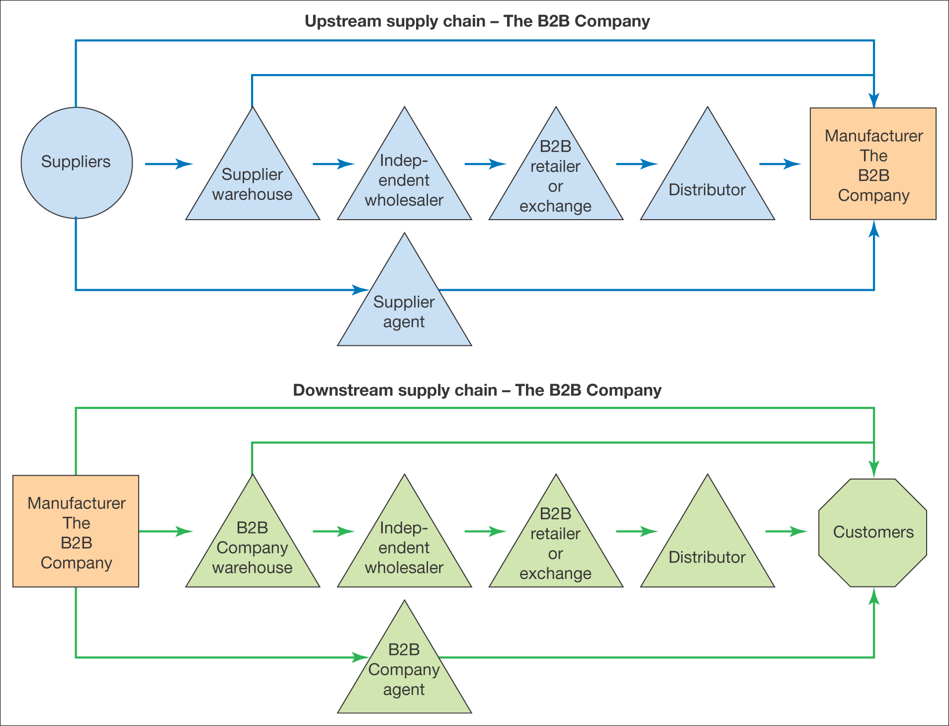
Figure 6.2 A typical supply chain (an example from The B2B Company)

Slide 12
A simple model of supply chain
Acquisition of resources (inputs)
Transformation (process)
Products and services (outputs)

Slide 13
What is logistics?
Used to refer specifically to the management of logistics or inbound and outbound logistics
Inbound logistics: The management of material resources entering an organization from its suppliers and other partners
Outbound logistics: The management of material resources supplied from an organization to its customers and intermediaries

Slide 14
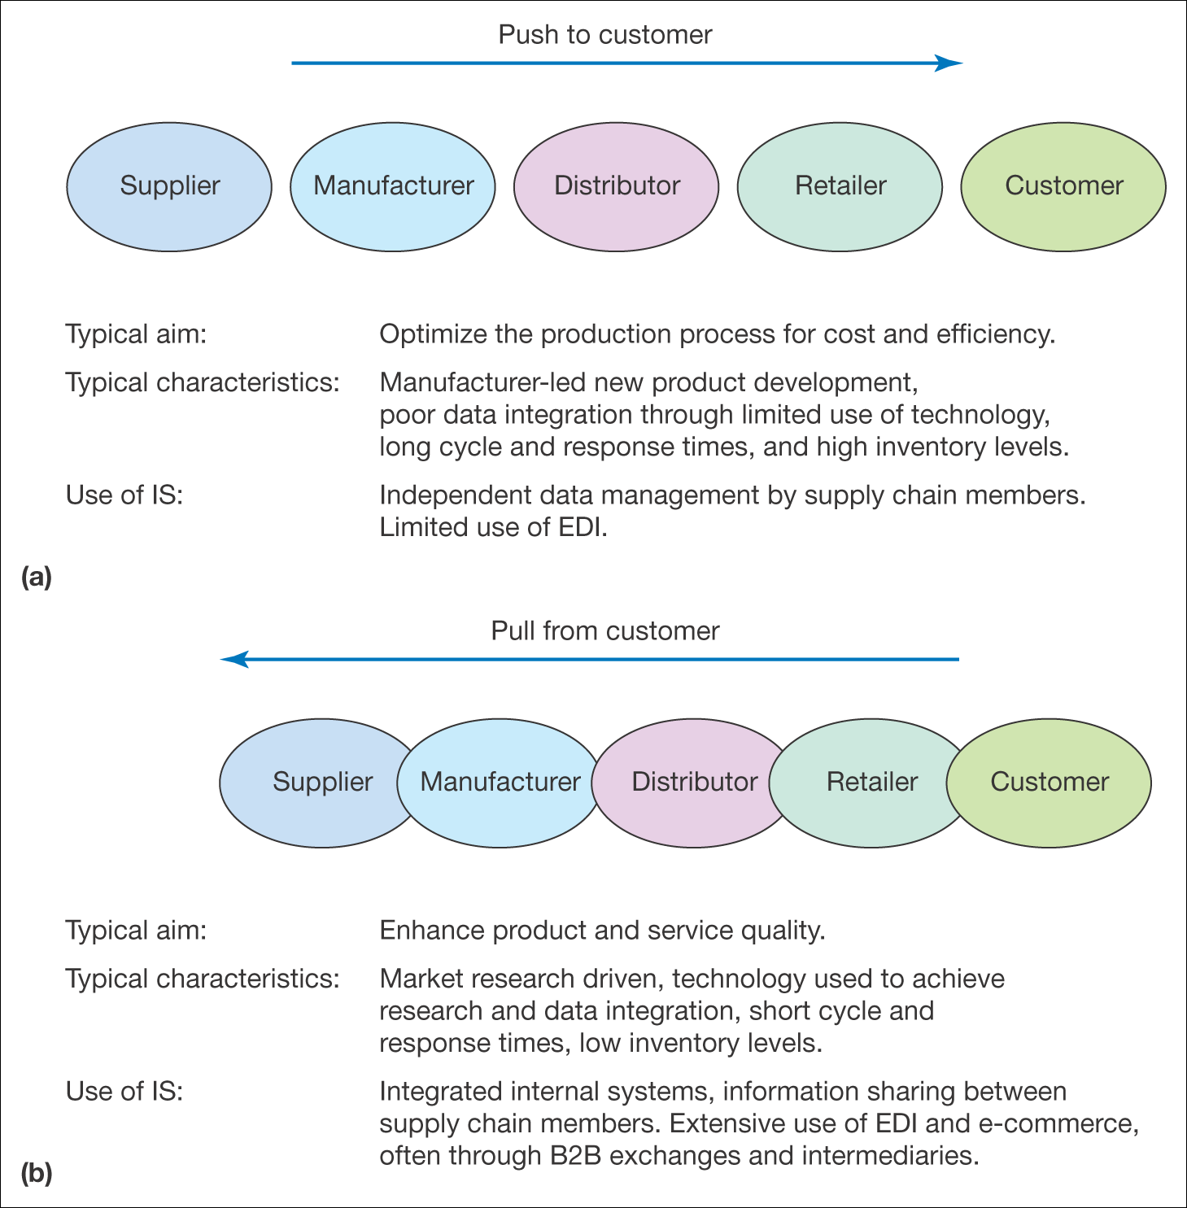
Push and pull supply chain models
Figure 6.3 Push and pull approaches to supply chain management

Slide 15
The Value Chain
A model that considers how supply chain activities can add value to products and services to be delivered to the customer

Slide 16
Restructuring the internal value chain
Some weaknesses in the traditional value chain:
  Most applicable to manufacturing of physical products
  It is a one-way chain involved with pushing products to the customer
  Does not emphasise the importance of value networks
Deise et al. (2000) adapted a new model

Slide 17
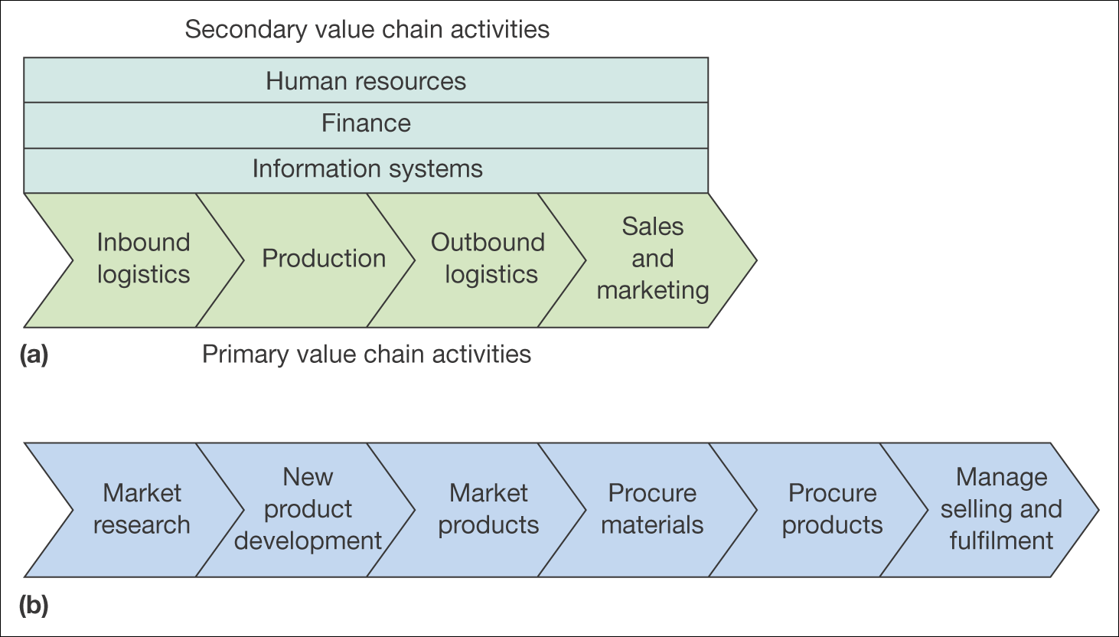
Figure 6.4 Two alternative models of the value chain: (a) traditional value chain model, (b) revised value chain model
Source: Figure 6.4(b) adapted from Deise et al. (2000)

Slide 18
Towards virtual organization
An organization which uses information and communication technology to allow it to operate without clearly defined physical boundaries between different functions
  Lack of physical structure
  Reliance of knowledge
  Use of communications technology
  Mobile work
  Boundaryless and inclusive
  Flexible and responsive

Slide 19
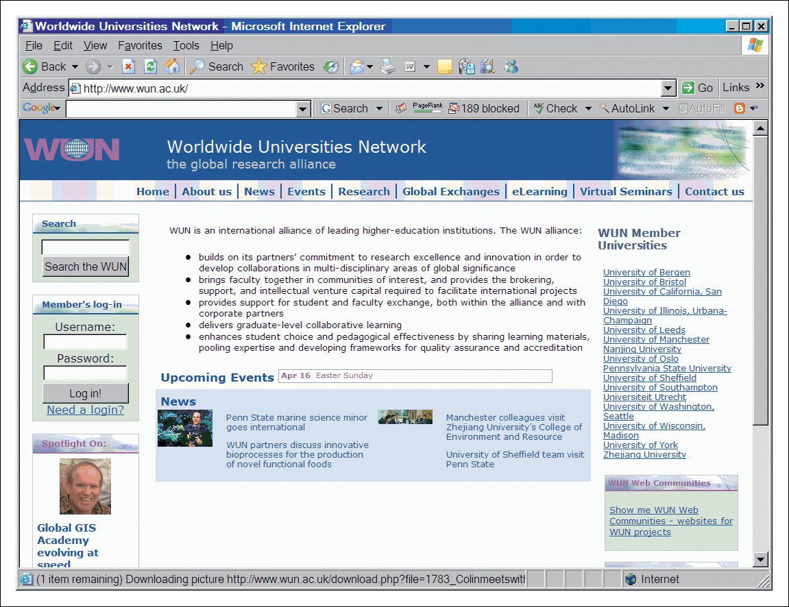
Figure 6.6 The Worldwide Universities Network showing member institutions (www.wun.ac.uk)

Slide 20
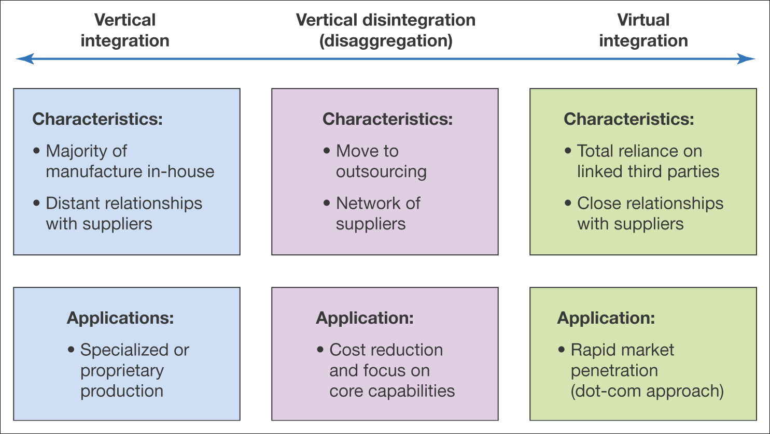
Options for restructuring the supply chain
Figure 6.7 The characteristics of vertical integration, vertical disintegration and
virtual integration

Slide 21
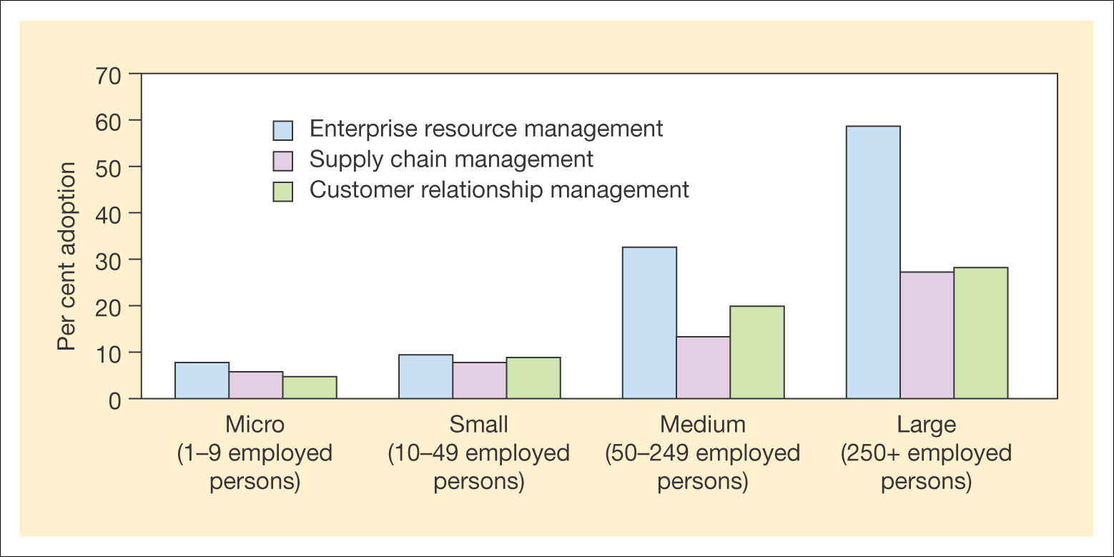
Figure 6.8 Popularity of different e-business applications in Europe according to company size
Source: eEurope (2005)

Slide 22
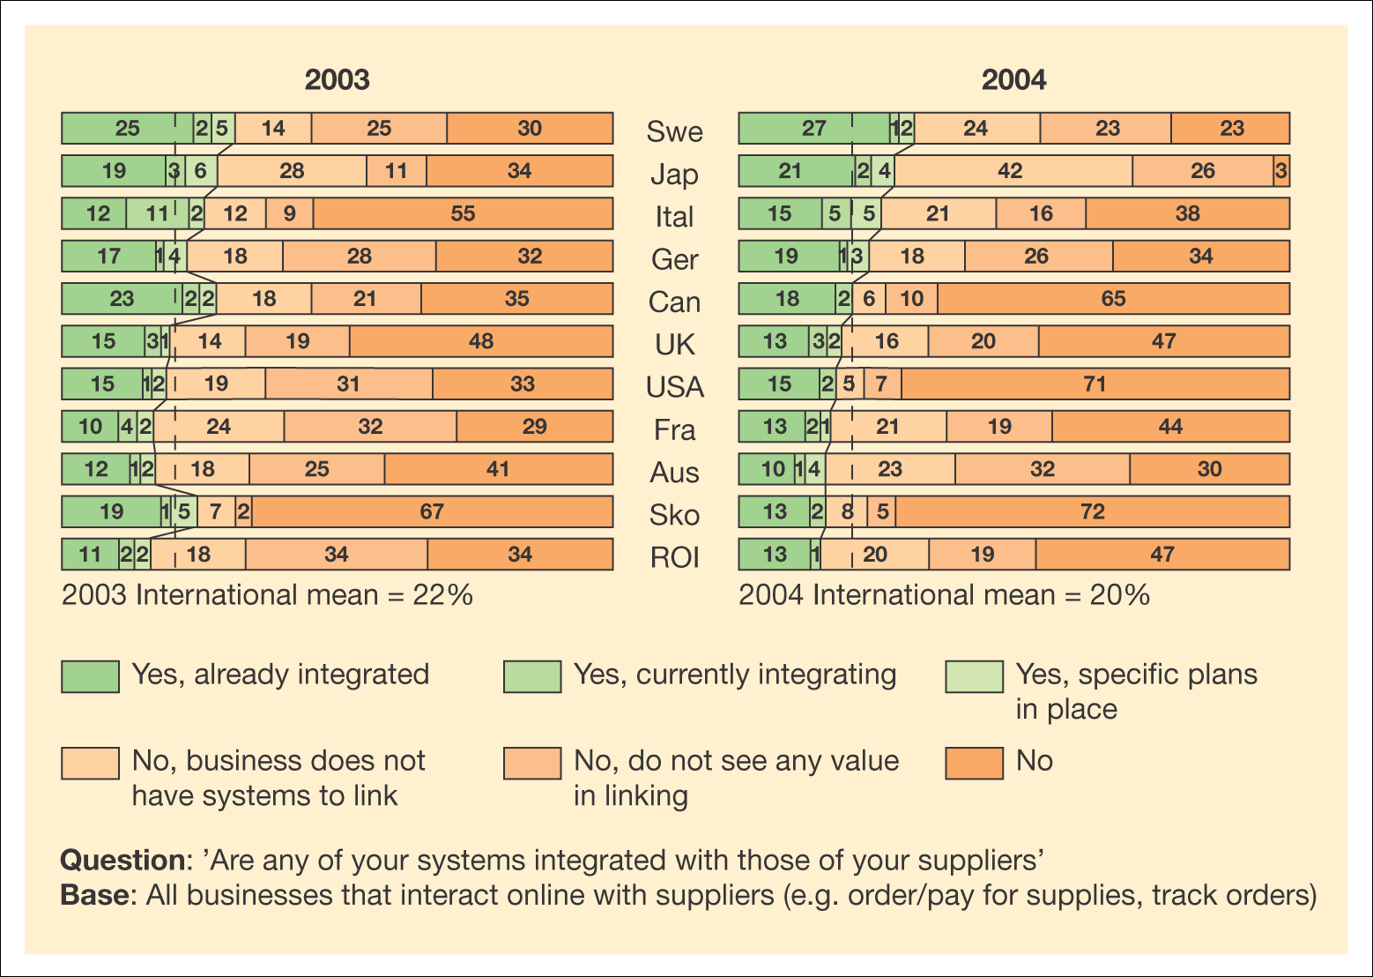
Figure 6.9 Proportion of businesses that integrate with their suppliers, or plan to
Source: DTI (2004), Fig. 7.5b

Slide 23
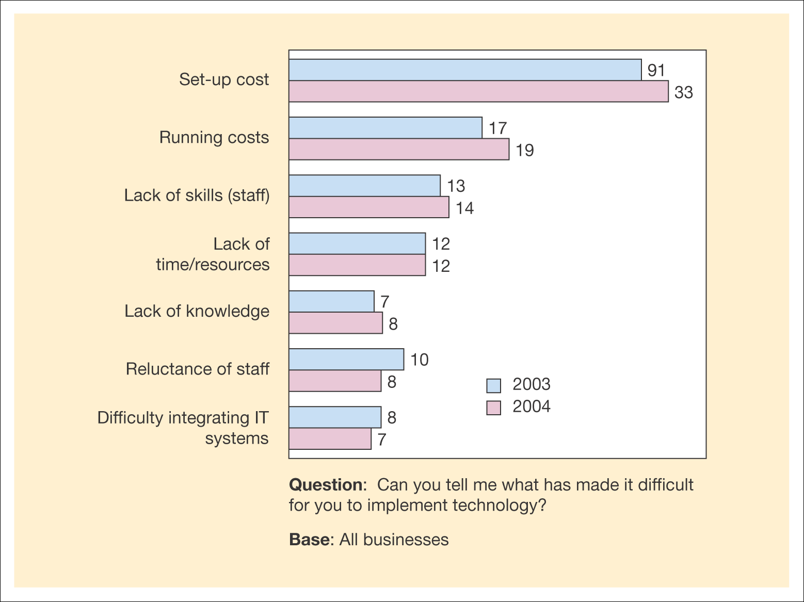
Figure 6.10 Barriers to implementing information and communications technology
Source: DTI (2004), Fig. 5.2f

Slide 24
Benefits of applying IS to SCM
Increased efficiency of individual processes
  Benefit: reduced cycle time and cost per order as described in Chapter 7
Reduced complexity of the supply chain
  Benefit: reduced cost of channel distribution and sale
Improved data integration between elements of the supply chain
  Benefit: reduced cost of paper processing
Reduced cost through outsourcing
  Benefits: lower costs through price competition and reduced spend on manufacturing capacity and holding capacity. Better service quality through contractual arrangements?
Innovation
  Benefit: better customer responsiveness.

Slide 25
Benefits to buying company
Increased convenience through 24 hours a day, 7 days a week, 365 days ordering
Increased choice of supplier leading to lower costs
Faster lead times and lower costs through reduced inventory holding
The facility to tailor products more readily
Increased information about products and transactions such as technical data sheets and order histories

Slide 26
IS-supported upstream SCM
RFID (radio-frequency identification microchip)
  Microchip-based electronic tags are used for monitoring anything they are attached to

Slide 27
IS-supported downstream SCM
Involves selling direct to customers
Operating a strategy of disintermediation by reducing the role of its branches

Slide 28
Outbound logistic management
Relates to the expectations of offering sales through a web site

Slide 29
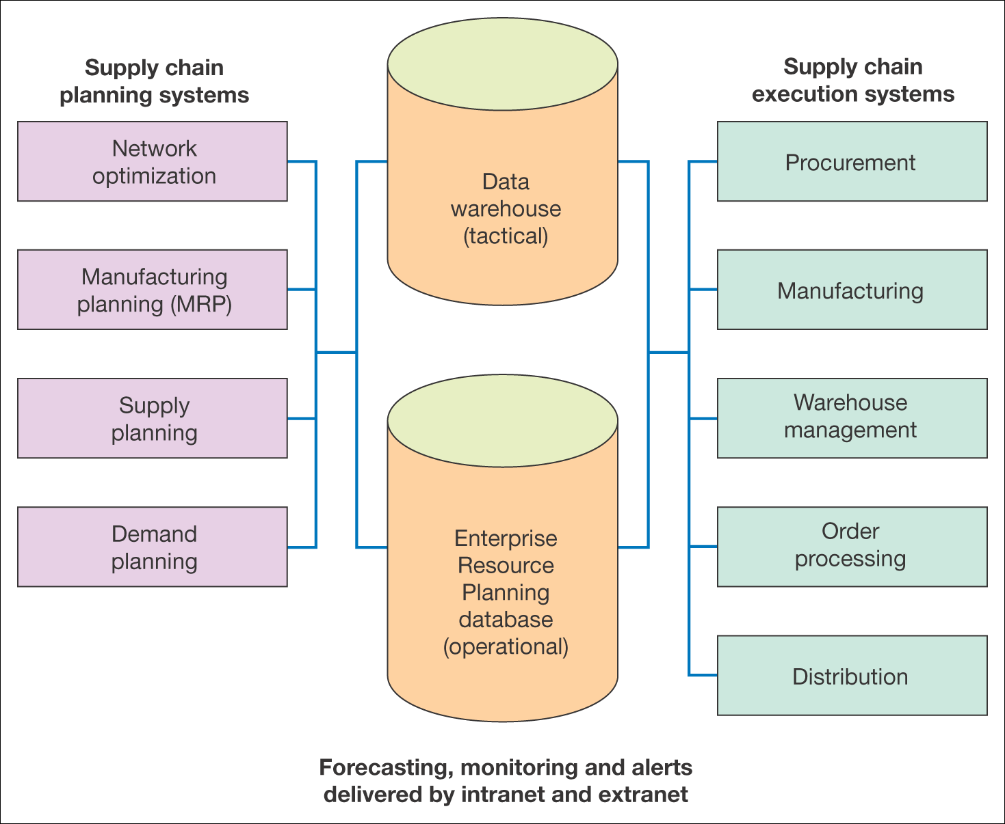
Figure 6.11 A typical IS infrastructure for supply chain management

Slide 30
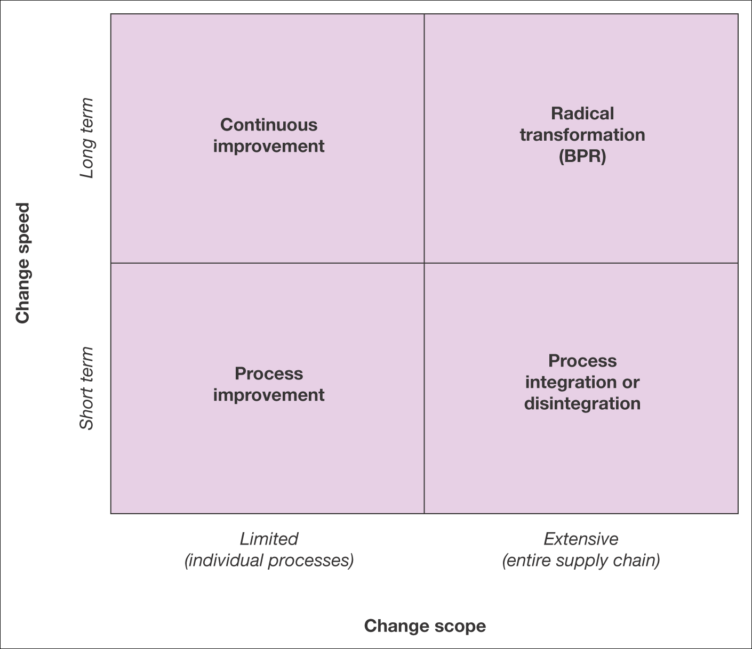
Figure 6.12 Alternative strategies for modification of the e-business supply chain

